Slide 1
Chelating agents
Pharmacology SDL project
Group no. 10
Section B10

Slide 2
Index
Definition
Dimercaprol
Succimer
Edeta
Calcium disodium edetate
Pencillamine
Desferrioxamine of Chelating agents

Slide 3
Definition
They are organic compounds which bind with heavy metal ions to form firmly bound complexes which are non-toxic and easily excreted in urine

Slide 4
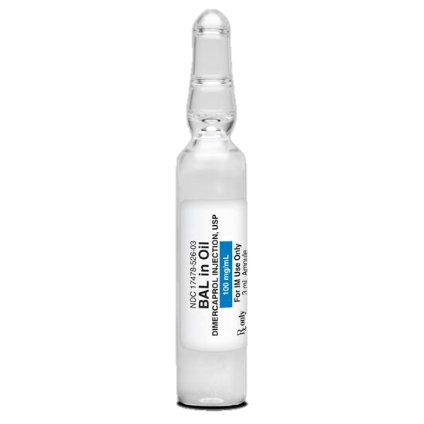
Dimercaprol (bal)
It is effective in treatment of acute poisoning of metal
E.g. arsenic, mercury, antimony as affinity of BAL to metal ions is greater than that metal to tissue enzymes.

Slide 5
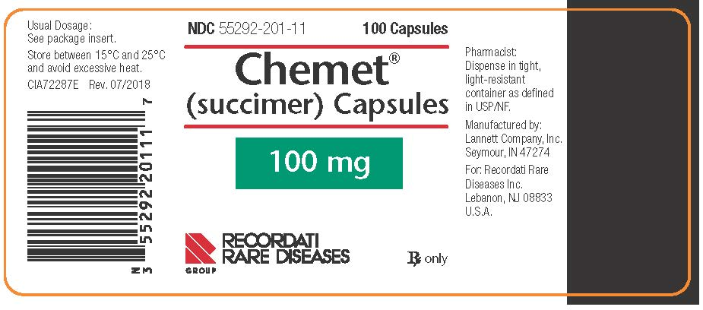
Succimer (di-mercapto succinic acid) dmsa
Used for the treatment of high blood lead concentrations, and mercury poisoning .
Mechanism: It binds with high specificity ions of lead in the blood to form a water-soluble complex excreted by kidneys.

Slide 6
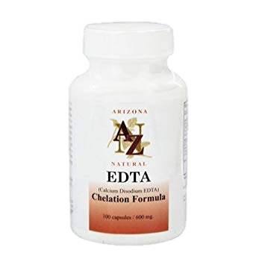
Edta (Ethylene diamine tetracyclic acid)
it is effective in treatment of poisoning with Ca++.
Mechanism: once injected to the blood stream, it circulates in blood, binding to Ca++ and collecting all the metal into a compound that’s filtered through the kidney and released in the urine.

Slide 7
Calcium disodium edetate
It is a salt of edetate with two sodium and one calcium atom
Mechanism: It is used by IV infusion to chelate lead in lead poisoning because lead has a great affinity for EDETA, than calcium and thus replaces calcium in this complex

Slide 8
Penicillamine
It is effective chelator of copper. It is mainly used in hepato -lenticular degeneration "Wilson's disease" it is may also be used for mercury, cobalt, lead to poisoning as well as rheumatoid arthritis.

Slide 9
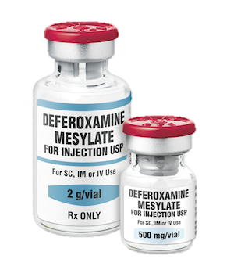
Desferrioxamine of Chelating agents
Selectively chelates iron in ferric state so, used in acute iron poisoning.

Slide 10
Chelating activity of some drugs:
Tetracycline
Salicylates
$$can chelate$$
$${Ca}^{++}, {Mg}^{++},{AL}^{++}$$
$$can chelate$$
$${Ca}^{++}, {Fe}^{++}$$

